Slide 1

Cambridge Dynamics
Emotional Support Horse

Slide 2
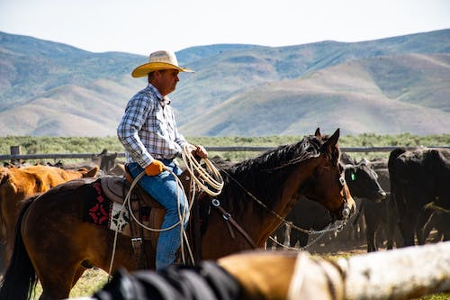
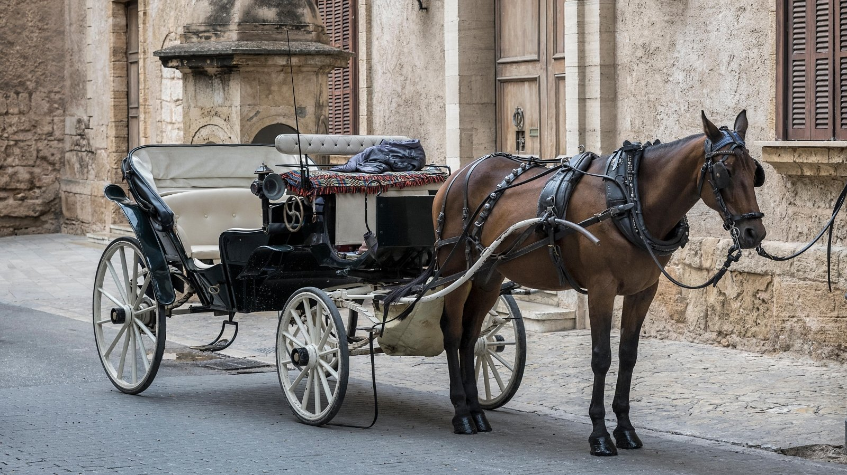

Horses have played an important role over the history of man

Slide 3

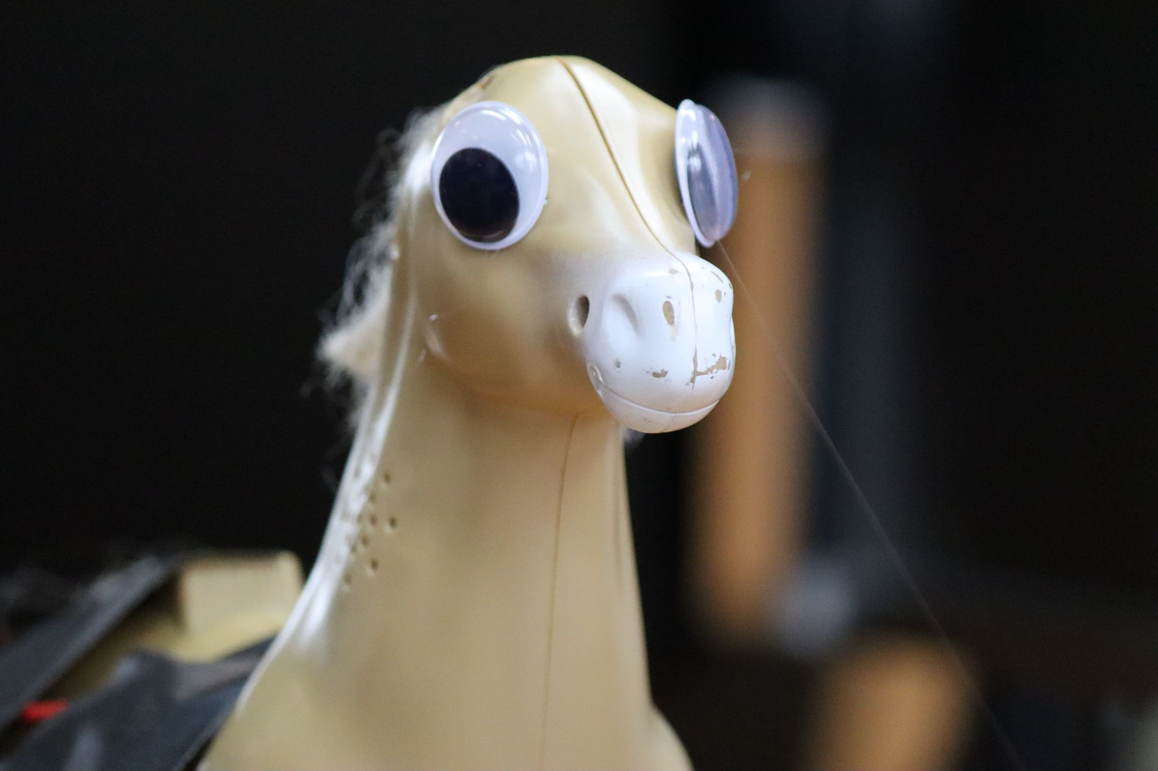
The Motivation Behind Cambridge Dynamics
Horse was found in a bin (very sad). We believe in the power of upcycling here at Cambridge Dynamics, by leveraging the power of the existing hardware, we gave this horse a new life as an emotional support horse!
Why the long face? Think you’re a horse?

Slide 4
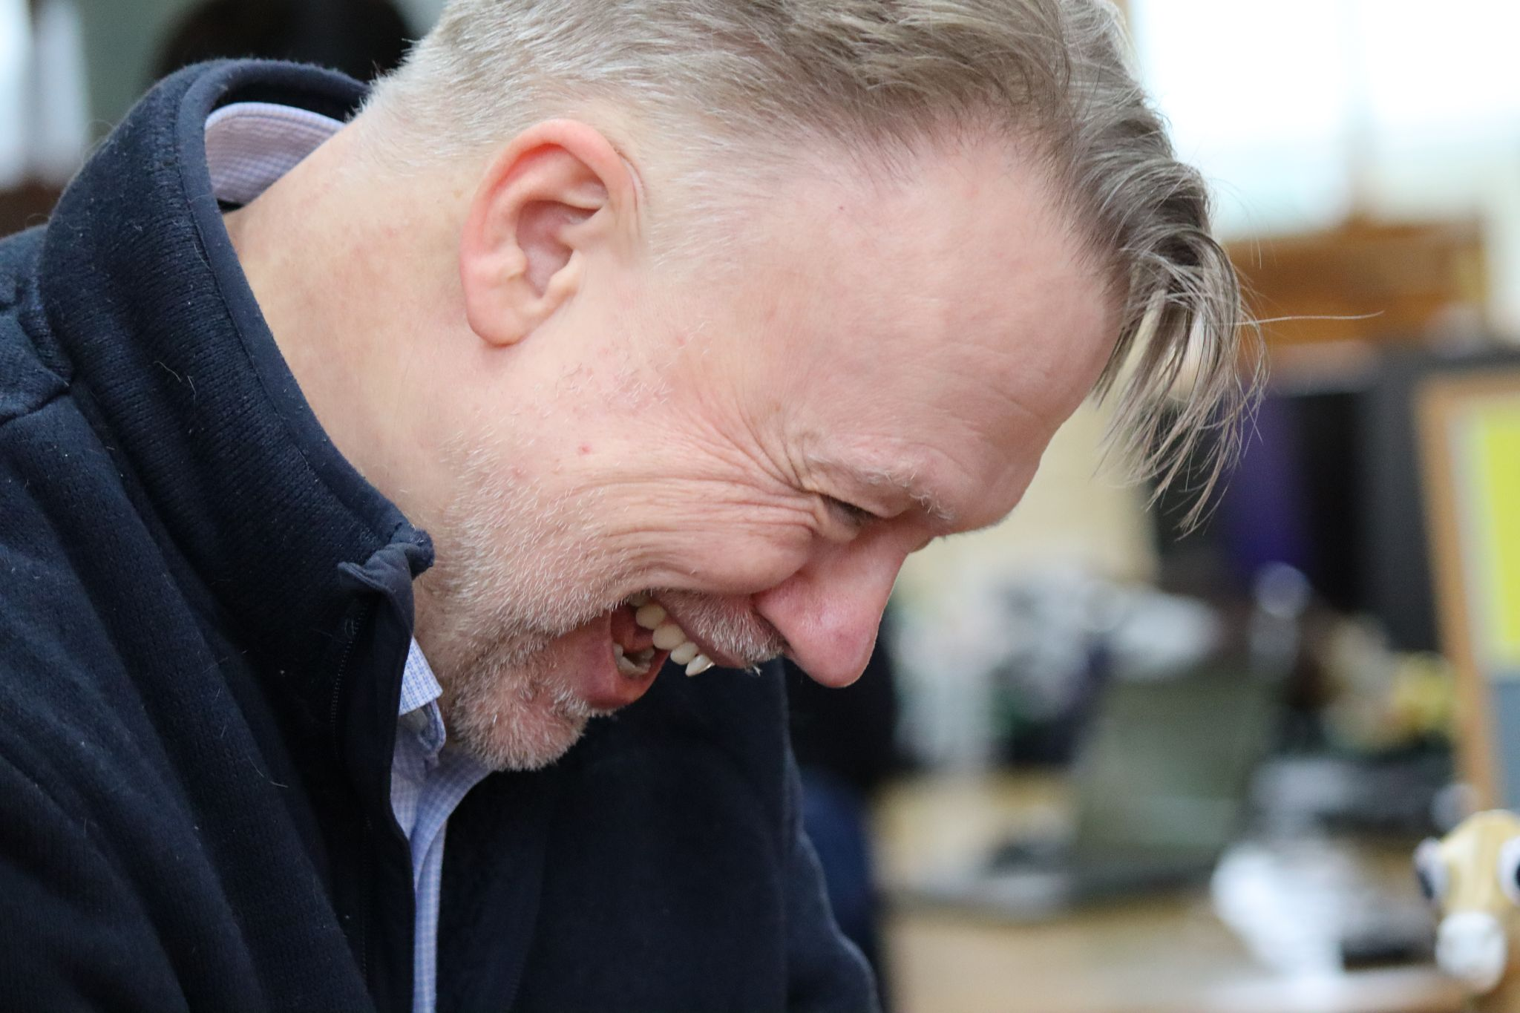
Horse Makes You Happy
Our country is in the midst of a mental health crisis, by providing happy little horses to vulnerable people it can make a real difference in their times of need.
Straight from the horse's mouth

Slide 5
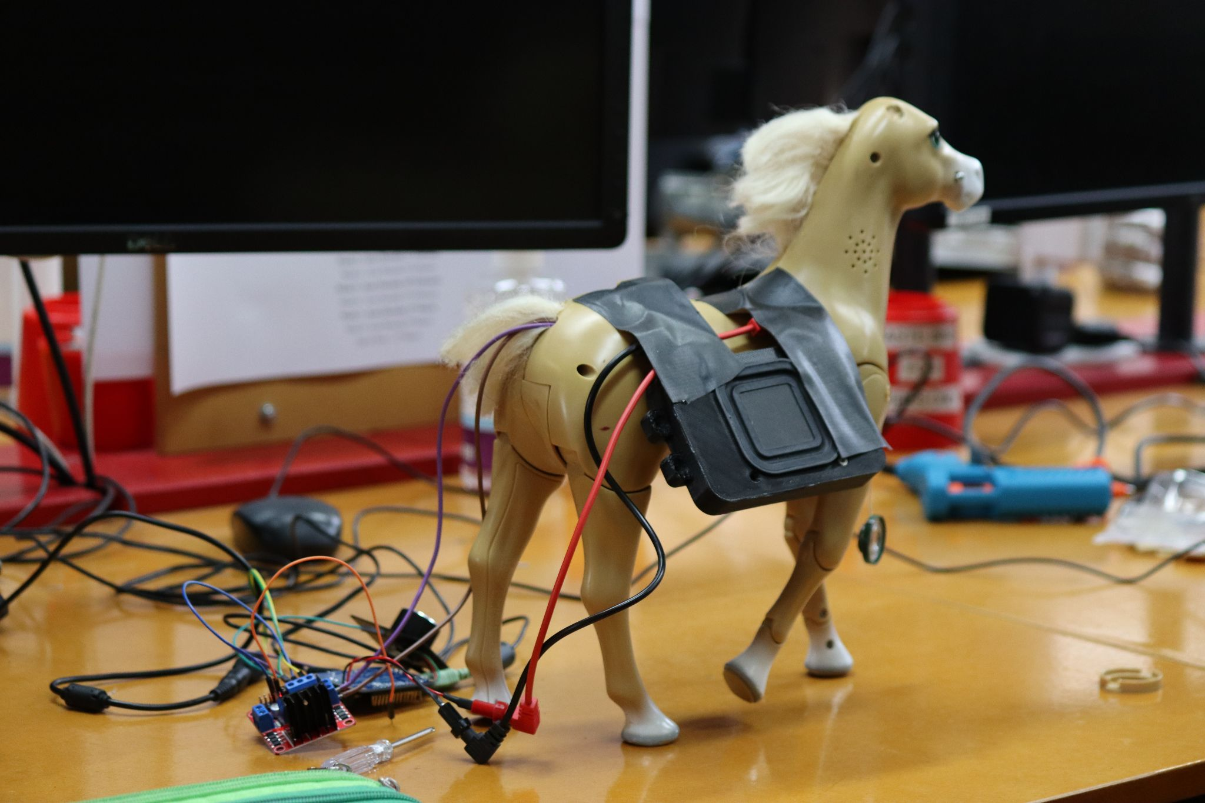
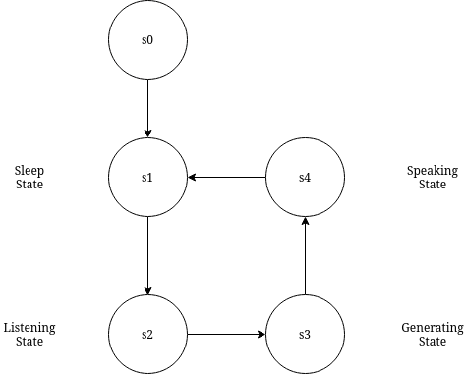
Engineering The Stallion
Slow and steady wins the race
The horse is basically a finite state machine. This allowed the software parts to be made in parallel.

Slide 6
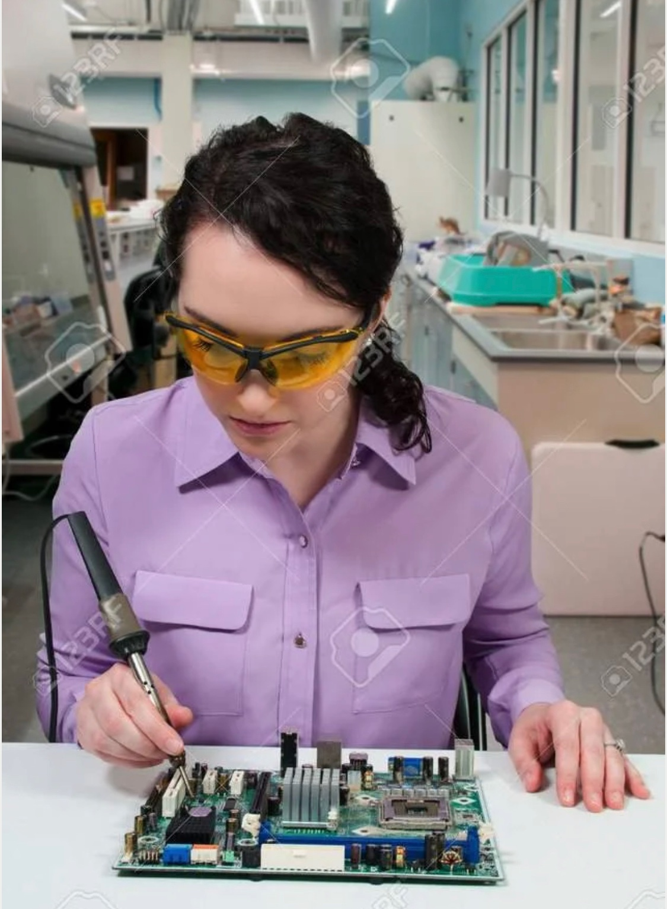
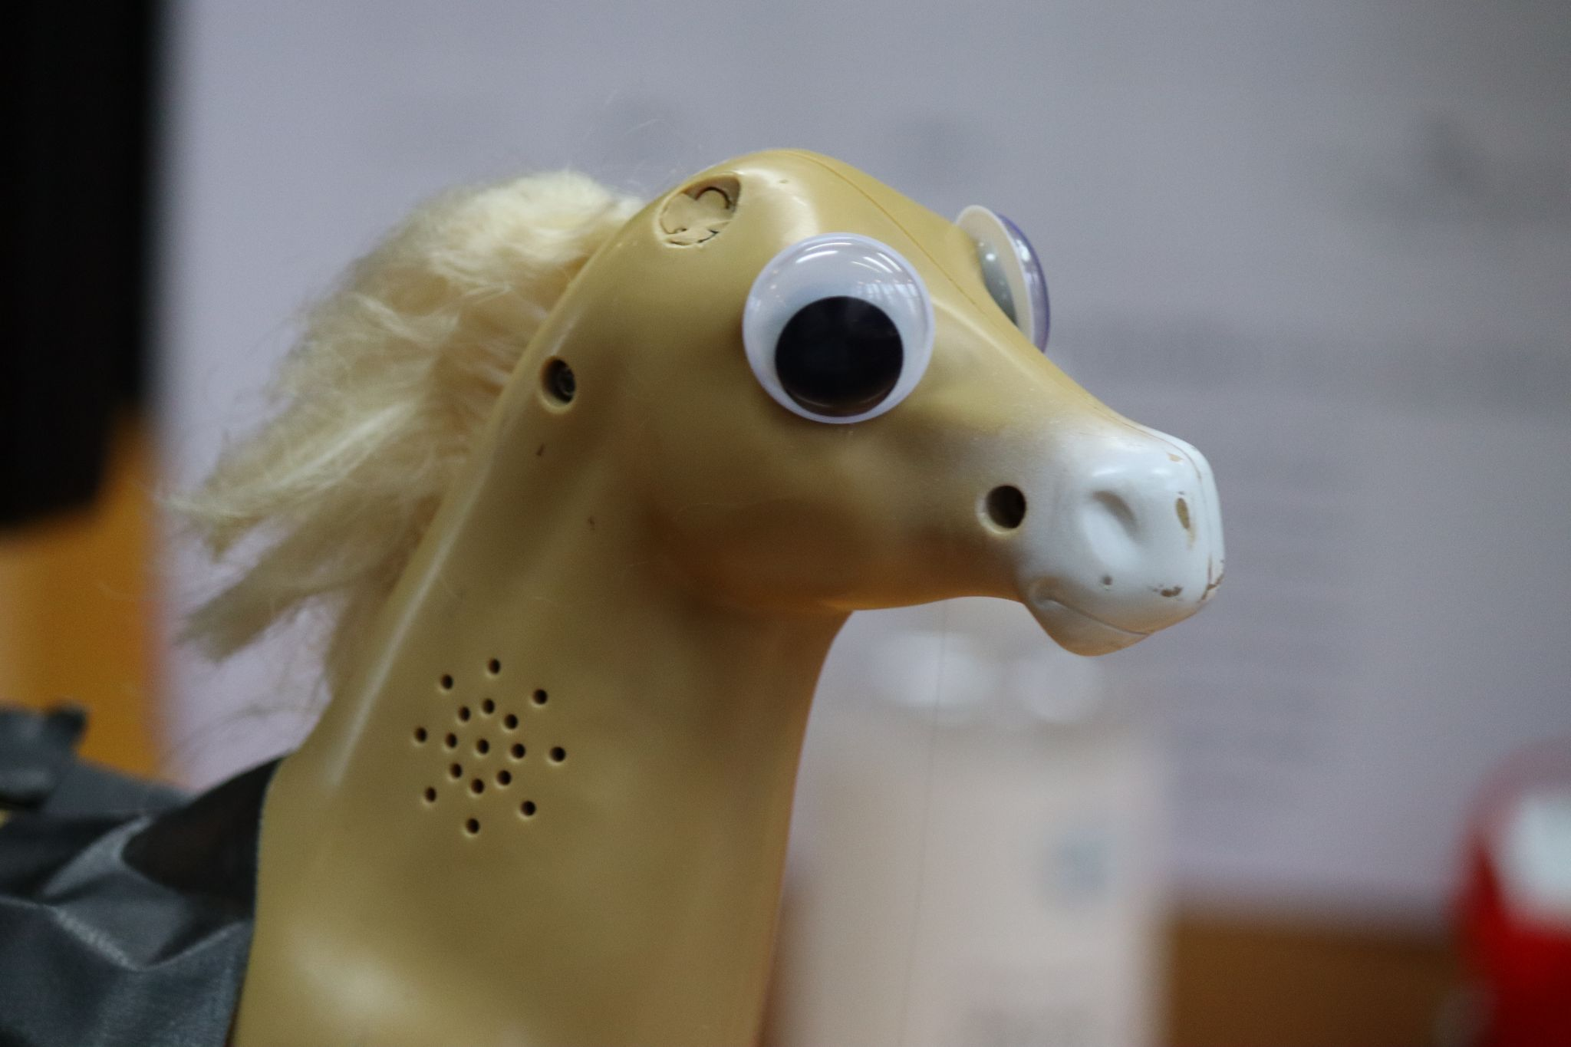

Hardware
We needed a way to control the horse remotely
We interface directly with the drive system, leveraging existing locomotion infrastructure
This was my mane concern
User interface was via an intuitive button

Slide 7
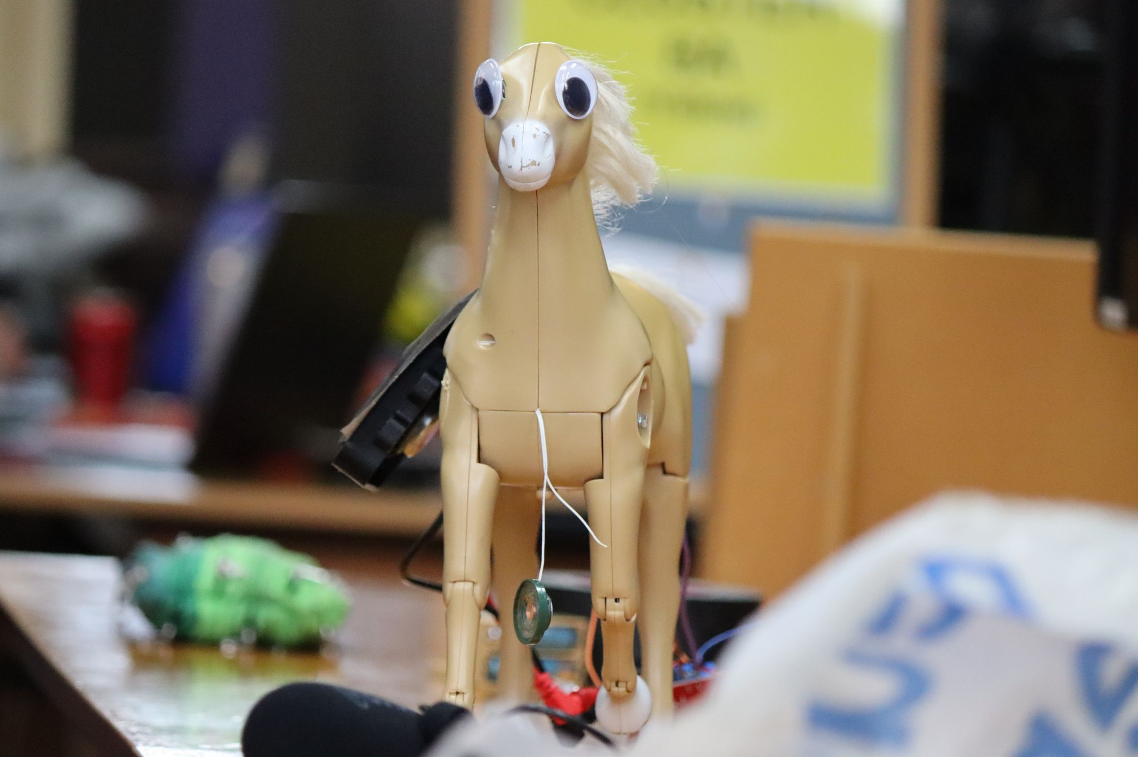
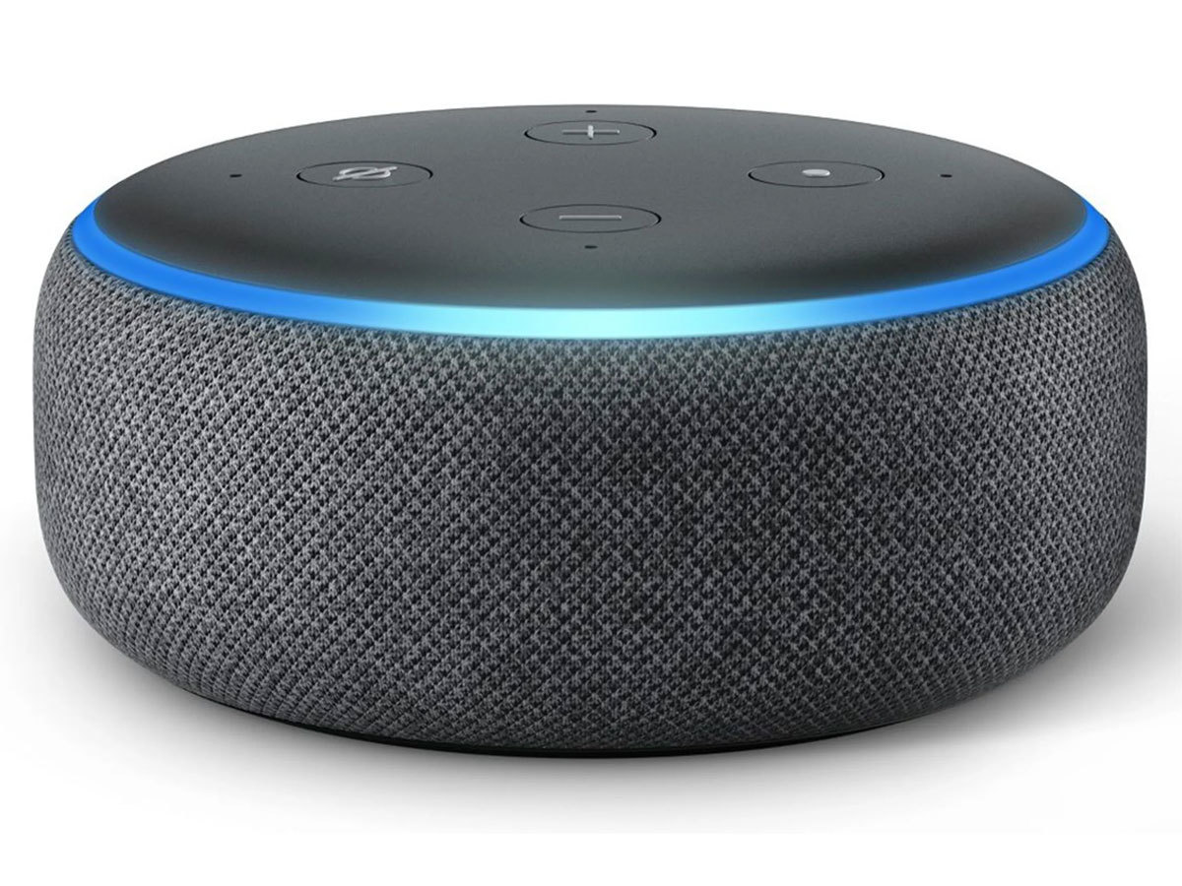
Speech Synthesis
Realistic sounding audio was generated using eleven labs speech synthesis api. Training a model (with waveglow for example) would be too time consuming for a hackathon.
Alexa play Despacito

Slide 8
ChatGPT

Slide 9
Using NLP For Context Aware Chats
An expertly and delicately crafted prompt created our revolutionary therapy animal, using cutting edge technology such as the openAI gpt-3.5-turbo model (used in ChatGPT too), with the outer look as a cute horse, it performs exceedingly well in its comforting and supporting job

